Slide 1
Electronic transfer of EHR data to EDC Project by whileTruecode, Second year SRM IST Students

Slide 2
INDEX
1. What & Why are we trying to solve?
2. How are we trying to solve? 2a. NLP (BOA) 2b. Data Lakes
3. Business Model Canva
4. Members & Mentors

Slide 3
What are we trying to solve?
Manual transcription of data from EHR to EDC is time consuming and this process is error prone
Clinical Research Associates are spending their valuable time to cross check the EDC data against the data present in EHR to ensure its correctness.
Why are we trying to solve?
The major objective of this project is to minimise time while uploading the data, avoid errors while manually transcribing data from EHR to EDC, and do away with the requirement for cross-verifying the data's accuracy.
Main objectives:
To reduce time
Prevent error in data
Prevent re-evaluating data

Slide 4
How are we trying to solve?
Needed scenario:
Electronically transfer relevant data from EHR to EDC thus eliminating the need to manually transcribe data into EDC.
Here we don’t try to convert different types of ehr data into the same datatype when we upload it into edc servers. Instead we keep the originality of the source files after verifying them. As we are using data lakes structures to varsity of data types can be present and also can be accessed in a organised manner resulting in quicker query resolving.
How we achieve this:
NLP (BOA)
Data lakes

Slide 5
Natural Language Processing
This involves automatically summarizing text and finding important pieces of data. One example of this is keyword extraction, which pulls the most important words from the text, which can be useful for search engine optimization. This can be used in analysis of data in shorter time.
Butterfly optimization algorithm (BOA) - mimics food search and mating behavior of butterflies, to solve global optimization problems. The framework is mainly based on the foraging strategy of butterflies, which utilize their sense of smell to determine the location of nectar or mating partner.

Slide 6
Data Lake
What is a Data Lake?: A data lake is a centralized repository designed to store, process, and secure large amounts of structured, semi structured, and unstructured data. It can store data in its native format and process any variety of it, ignoring size limits.
Why Data Lake? Cost: Data collection is a priority for all healthcare organizations. Archiving and retirement provide the necessary technologies to reduce cost across the organization. Compliance: Having a healthcare Data Lake in place helps meet strict compliance requirements, like GDPR, since data can be monitored and secured. Cash: Healthcare organizations are running on laser thin margins — optimizing on cash and collections will help operations. Cloud: Migration to the cloud has huge benefits — cost, speed, scalability, and much more. Customer: A 360 view of the customer with potential to upsell and cross-sell, for all. For instance, Providers can predict and potentially prevent diseases, with the help of predictive analytics.
How to Set Up a Data Lake in Your Healthcare Organization - Establishing a data lake can take one of two forms. First, you can follow the traditional route by setting it up within your organization’s own data centres. This is known as an “on-premises” data lake. - Alternatively, you can set it up using cloud services like Google Cloud, Microsoft Azure, or Amazon AWS. These are known as “cloud-based” data lakes. Each method has its advantages and disadvantages. - We can help you decide which method is right for your organization. Once your data lake is up and running, our managed services will keep it performing at its peak.

Slide 7
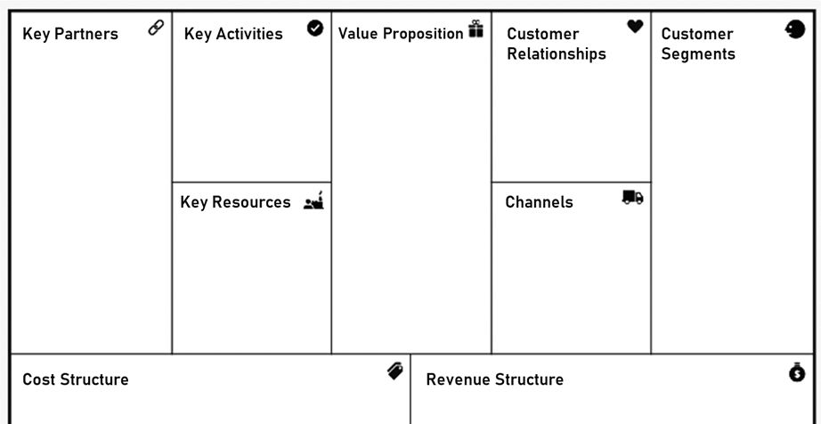
BMC
Time efficient
Quality improvement.
Avoiding re-checking of EDC data.
Time saving
Data abundancy
Organised data
Easy access.
Patient data
Hospital records
Relatable health records.
Availability of resources.
SRM Hospitals.
Health care Industries
Cloud service providers.
Works with all kind of EHR and EDC systems.
SRM Hospitals
Health care. Industries.
Application
Website.
System cost
Database cost
Cloud services cost.
Hospitals
Health care industries
Doctors.

Slide 8
The Team: whileTruecode
Members:
Rohith, Team Lead & Domain Expert
Jayakrishna, UX/UI Designer
Rishi, Developer: Frontend & Backend
Mentors:
Ms. Judy Flavia, AP/ CSE SRM IST RMP
Dr. Ballika J Chelliah, HOD of AI & ML SRM IST RMP

Slide 9
Bibilogy
https://cloud.google.com/learn/what-is-a-data-lake
https://aws.amazon.com/big-data/datalakes-and-analytics/what-is-a-data-lake/
https://www.solix.com/blog/healthcare-data-lake/
https://www.truenorthitg.com/data-lakes-in-healthcare/
https://www.researchgate.net/publication/323642224_Butterfly_optimization_algorithm_a_novel_approach_for_global_optimization

